Slide 1
Chapter 6
Digital Design and Computer Architecture: ARM® Edition
Sarah L. Harris and David Money Harris

Slide 2
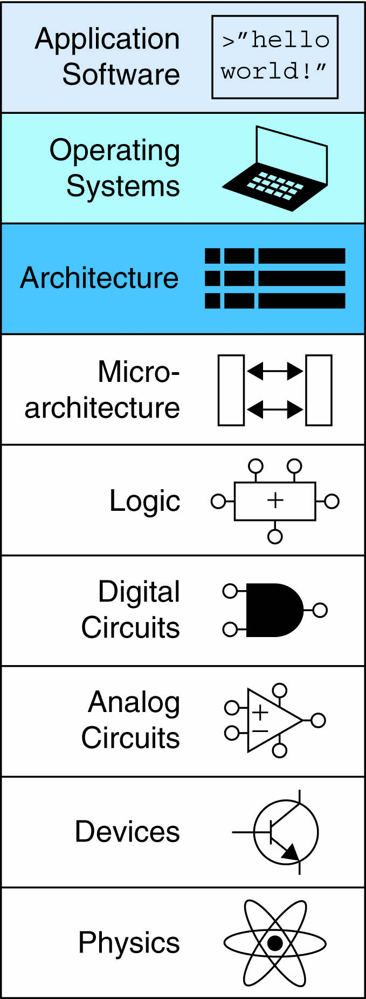
Chapter 6 :: Topics
Introduction
Assembly Language
Machine Language
Programming
Addressing Modes

Slide 3
Introduction
Jumping up a few levels of abstraction
Architecture: programmer’s view of computer
Defined by instructions & operand locations
Microarchitecture: how to implement an architecture in hardware (covered in Chapter 7)

Slide 4
Instructions
Commands in a computer’s language
Assembly language: human-readable format of instructions
Machine language: computer-readable format (1’s and 0’s)

Slide 5
ARM Architecture
Developed in the 1980’s by Advanced RISC Machines – now called ARM Holdings
Nearly 10 billion ARM processors sold/year
Almost all cell phones and tablets have multiple ARM processors
Over 75% of humans use products with an ARM processor
Used in servers, cameras, robots, cars, pinball machines, etc.

Slide 6
ARM Architecture
Developed in the 1980’s by Advanced RISC Machines – now called ARM Holdings
Nearly 10 billion ARM processors sold/year
Almost all cell phones and tablets have multiple ARM processors
Over 75% of humans use products with an ARM processor
Used in servers, cameras, robots, cars, pinball machines,, etc.
Once you’ve learned one architecture, it’s easier to learn others

Slide 7
Architecture Design Principles
Underlying design principles, as articulated by Hennessy and Patterson:
Regularity supports design simplicity
Make the common case fast
Smaller is faster
Good design demands good compromises

Slide 8
Instruction: Addition
ADD: mnemonic – indicates operation to perform
b, c: source operands
a: destination operand
C Code
a = b + c;
ARM Assembly Code
ADD a, b, c

Slide 9
Instruction: Subtraction
Similar to addition - only mnemonic changes
SUB: mnemonic
b, c: source operands
a: destination operand
C Code
a = b - c;
ARM assembly code
SUB a, b, c

Slide 10
Design Principle 1
Regularity supports design simplicity
Consistent instruction format
Same number of operands (two sources and one destination)
Ease of encoding and handling in hardware

Slide 11
Multiple Instructions
More complex code handled by multiple ARM instructions
C Code
a = b + c - d;
ARM assembly code
ADD t, b, c ; t = b + c
SUB a, t, d ; a = t - d

Slide 12
Design Principle 2
Make the common case fast
ARM includes only simple, commonly used instructions
Hardware to decode and execute instructions kept simple, small, and fast
More complex instructions (that are less common) performed using multiple simple instructions

Slide 13
Design Principle 2
Make the common case fast
ARM is a Reduced Instruction Set Computer (RISC), with a small number of simple instructions
Other architectures, such as Intel’s x86, are Complex Instruction Set Computers (CISC)

Slide 14
Operand Location
Physical location in computer
Registers
Constants (also called immediates)
Memory

Slide 15
Operands: Registers
ARM has 16 registers
Registers are faster than memory
Each register is 32 bits
ARM is called a “32-bit architecture” because it operates on 32-bit data

Slide 16
Design Principle 3
Smaller is Faster
ARM includes only a small number of registers

Slide 17
ARM Register Set
Name | Use
R0 | Argument / return value / temporary variable
R1-R3 | Argument / temporary variables
R4-R11 | Saved variables
R12 | Temporary variable
R13 (SP) | Stack Pointer
R14 (LR) | Link Register
R15 (PC) | Program Counter

Slide 18
Operands: Registers
Registers:
R before number, all capitals
Example: “R0” or “register zero” or “register R0”

Slide 19
Operands: Registers
Registers used for specific purposes:
Saved registers: R4-R11 hold variables
Temporary registers: R0-R3 and R12, hold intermediate values
Discuss others later

Slide 20
Instructions with Registers
Revisit ADD instruction
C Code
a = b + c;
ARM Assembly Code
; R0 = a, R1 = b, R2 = c
ADD R0, R1, R2

Slide 21
Operands: Constants\Immediates
Many instructions can use constants or immediate operands
For example: ADD and SUB
value is immediately available from instruction
C Code
a = a + 4;
b = a – 12;
ARM Assembly Code
; R0 = a, R1 = b
ADD R0, R0, #4
SUB R1, R0, #12

Slide 22
Generating Constants
Generating small constants using move (MOV):
C Code
//int: 32-bit signed word
int a = 23;
int b = 0x45;
ARM Assembly Code
; R0 = a, R1 = b
MOV R0, #23
MOV R1, #0x45

Slide 23
Generating Constants
Generating small constants using move (MOV):
Constant must have < 8 bits of precision
Note: MOV can also use 2 registers: MOV R7, R9
C Code
//int: 32-bit signed word
int a = 23;
int b = 0x45;
ARM Assembly Code
; R0 = a, R1 = b
MOV R0, #23
MOV R1, #0x45

Slide 24
Generating Constants
Generate larger constants using move (MOV) and or (ORR):
C Code
int a = 0x7EDC8765;
ARM Assembly Code
# R0 = a
MOV R0, #0x7E000000
ORR R0, R0, #0xDC0000
ORR R0, R0, #0x8700
ORR R0, R0, #0x65

Slide 25
Operands: Memory
Too much data to fit in only 16 registers
Store more data in memory
Memory is large, but slow
Commonly used variables still kept in registers

Slide 26
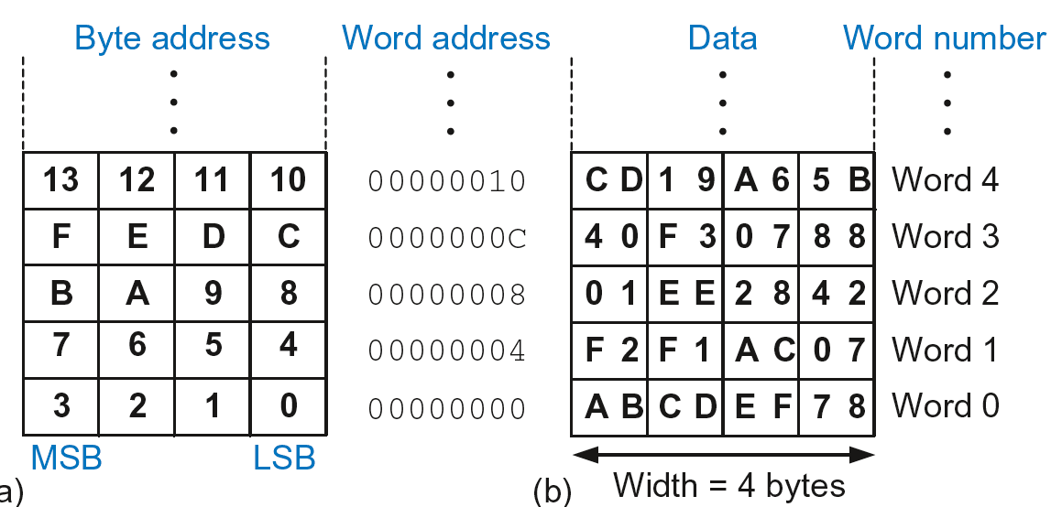
Byte-Addressable Memory
Each data byte has unique address
32-bit word = 4 bytes, so word address increments by 4

Slide 27
Reading Memory
Memory read called load
Mnemonic: load register (LDR)
Format:
LDR R0, [R1, #12]
Address calculation:
add base address (R1) to the offset (12)
address = (R1 + 12)
Result:
R0 holds the data at memory address (R1 + 12)
Any register may be used as base address

Slide 28
Reading Memory
Example: Read a word of data at memory address 8 into R3
Address = (R2 + 8) = 8
R3 = 0x01EE2842 after load
ARM Assembly Code
MOV R2, #0
LDR R3, [R2, #8]

Slide 29
Writing Memory
Memory write are called stores
Mnemonic: store register (STR)

Slide 30
Writing Memory
Example: Store the value held in R7 into memory word 21.
Memory address = 4 x 21 = 84 = 0x54
ARM assembly code
MOV R5, #0
STR R7, [R5, #0x54]
The offset can be written in decimal or hexadecimal

Slide 31
Recap: Accessing Memory
Address of a memory word must be multiplied by 4
Examples:
Address of memory word 2 = 2 × 4 = 8
Address of memory word 10 = 10 × 4 = 40

Slide 32
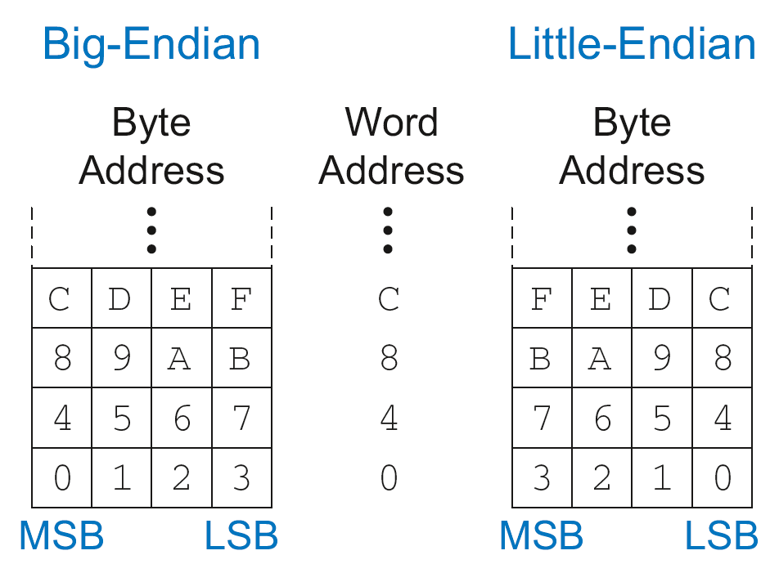
Big-Endian & Little-Endian Memory
How to number bytes within a word?
Little-endian: byte numbers start at the little (least significant) end
Big-endian: byte numbers start at the big (most significant) end

Slide 33
Big-Endian & Little-Endian Memory
Jonathan Swift’s Gulliver’s Travels: the Little-Endians broke their eggs on the little end of the egg and the Big-Endians broke their eggs on the big end
It doesn’t really matter which addressing type used – except when two systems share data

Slide 34
Big-Endian & Little-Endian Example
Suppose R2 and R5 hold the values 8 and 0x23456789
After following code runs on big-endian system, what value is in R7?
In a little-endian system?
STR R5, [R2, #0]
LDRB R7, [R2, #1]

Slide 35
Big-Endian & Little-Endian Example
Suppose R2 and R5 hold the values 8 and 0x23456789
After following code runs on big-endian system, what value is in R7?
In a little-endian system?
STR R5, [R2, #0]
LDRB R7, [R2, #1]
Big-endian: 0x00000045
Little-endian: 0x00000067

Slide 36
Programming
High-level languages:
e.g., C, Java, Python
Written at higher level of abstraction

Slide 37

Ada Lovelace, 1815-1852
British mathematician
Wrote the first computer program
Her program calculated the Bernoulli numbers on Charles Babbage’s Analytical Engine
She was a child of the poet Lord Byron

Slide 38
Programming Building Blocks
Data-processing Instructions
Conditional Execution
Branches
High-level Constructs:
if/else statements
for loops
while loops
arrays
function calls

Slide 39
Data-processing Instructions
Logical operations
Shifts / rotate
Multiplication

Slide 40
Logical Instructions
AND
ORR
EOR (XOR)
BIC (Bit Clear = A & ~B)
MVN (MoVe and NOT)

Slide 41
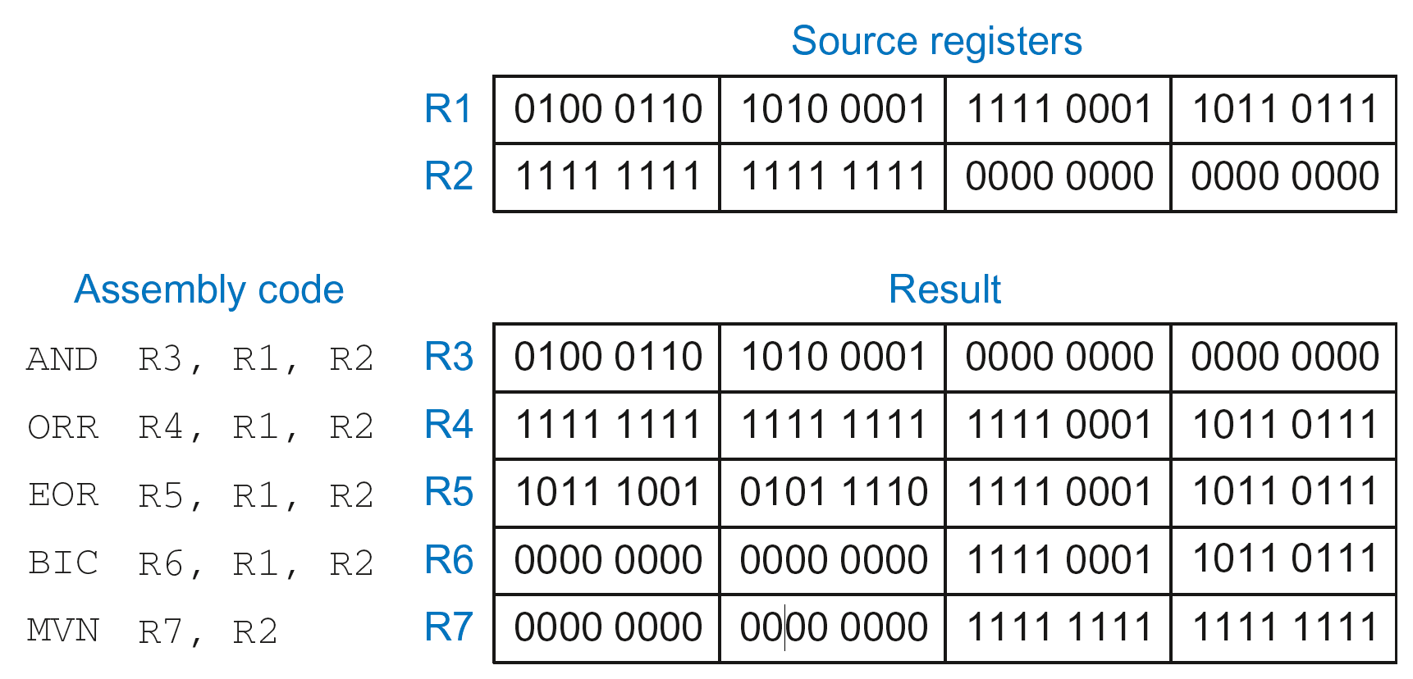
Logical Instructions: Examples

Slide 42
Logical Instructions: Examples

Slide 43
Logical Instructions: Examples

Slide 44
Logical Instructions: Examples

Slide 45
Logical Instructions: Examples

Slide 46
Logical Instructions: Examples

Slide 47
Logical Instructions: Uses
AND or BIC: useful for masking bits
Example: Masking all but the least significant byte of a value
0xF234012F AND 0x000000FF = 0x0000002F
0xF234012F BIC 0xFFFFFF00 = 0x0000002F
ORR: useful for combining bit fields
Example: Combine 0xF2340000 with 0x000012BC:
0xF2340000 ORR 0x000012BC = 0xF23412BC

Slide 48
Shift Instructions
LSL: logical shift left
Example: LSL R0, R7, #5 ; R0 = R7 << 5
LSR: logical shift right
Example: LSR R3, R2, #31 ; R3 = R2 >> 31
ASR: arithmetic shift right
Example: ASR R9, R11, R4 ; R9 = R11 >>> R4_{7:0}
ROR: rotate right
Example: ROR R8, R1, #3 ; R8 = R1 ROR 3

Slide 49
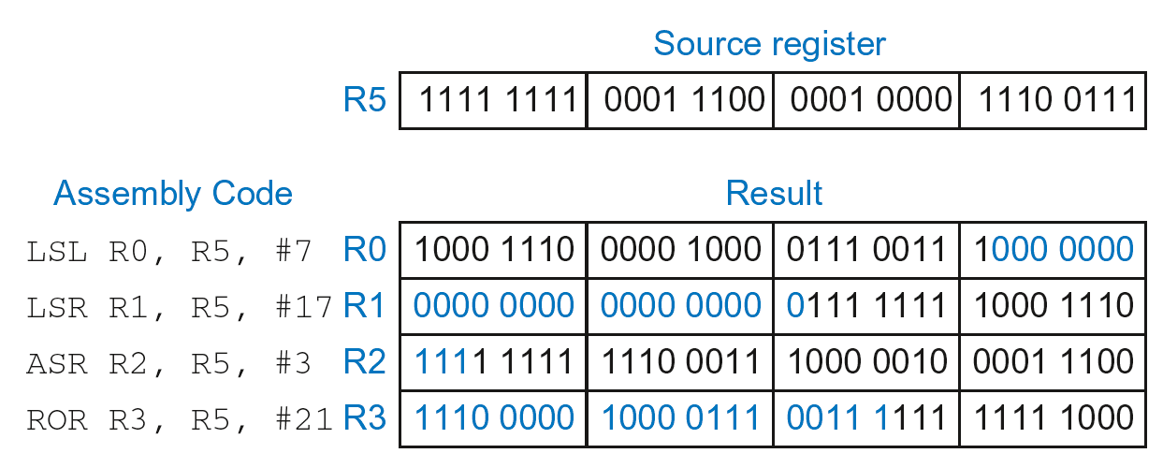
Shift Instructions: Example 1
Immediate shift amount (5-bit immediate)
Shift amount: 0-31

Slide 50
Shift Instructions: Example 1
Immediate shift amount (5-bit immediate)
Shift amount: 0-31

Slide 51
Shift Instructions: Example 1
Immediate shift amount (5-bit immediate)
Shift amount: 0-31

Slide 52
Shift Instructions: Example 1
Immediate shift amount (5-bit immediate)
Shift amount: 0-31

Slide 53
Shift Instructions: Example 1
Immediate shift amount (5-bit immediate)
Shift amount: 0-31

Slide 54
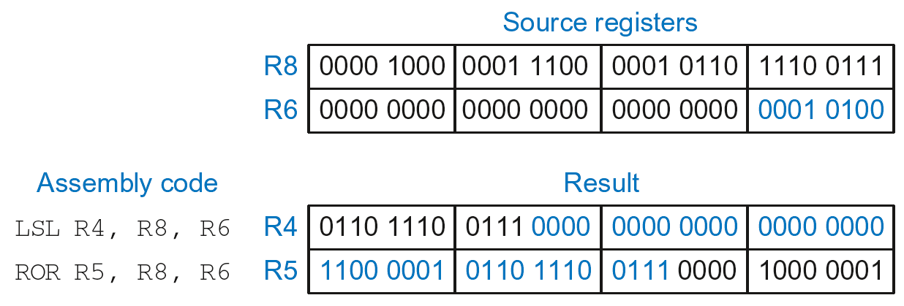
Shift Instructions: Example 2
Register shift amount (uses low 8 bits of register)
Shift amount: 0-255

Slide 55
Multiplication
MUL: 32 × 32 multiplication, 32-bit result
MUL R1, R2, R3
Result: R1 = (R2 x R3)_{31:0} (signed doesn’t matter)
UMULL: Unsigned multiply long: 32 × 32 multiplication, 64-bit result
UMULL R1, R2, R3, R4
Result: {R1,R2} = R3 x R4 (R3, R4 unsigned)
SMULL: Signed multiply long: 32 × 32 multiplication, 64-bit result
SMULL R1, R2, R3, R4
Result: {R1,R2} = R3 x R4 (R3, R4 signed)

Slide 56
Programming Building Blocks
Data-processing Instructions
Conditional Execution
Branches
High-level Constructs:
if/else statements
for loops
while loops
arrays
function calls

Slide 57
Conditional Execution
Don’t always want to execute code sequentially
For example:
if/else statements, while loops, etc.: only want to execute code if a condition is true
branching: jump to another portion of code if a condition is true

Slide 58
Conditional Execution
Don’t always want to execute code sequentially
For example:
if/else statements, while loops, etc.: only want to execute code if a condition is true
branching: jump to another portion of code if a condition is true
ARM includes condition flags that can be:
set by an instruction
used to conditionally execute an instruction

Slide 59
ARM Condition Flags
Flag | Name | Description
N | Negative | Instruction result is negative
Z | Zero | Instruction results in zero
C | Carry | Instruction causes an unsigned carry out
V | oVerflow | Instruction causes an overflow
Set by ALU (recall from Chapter 5)
Held in Current Program Status Register (CPSR)

Slide 60
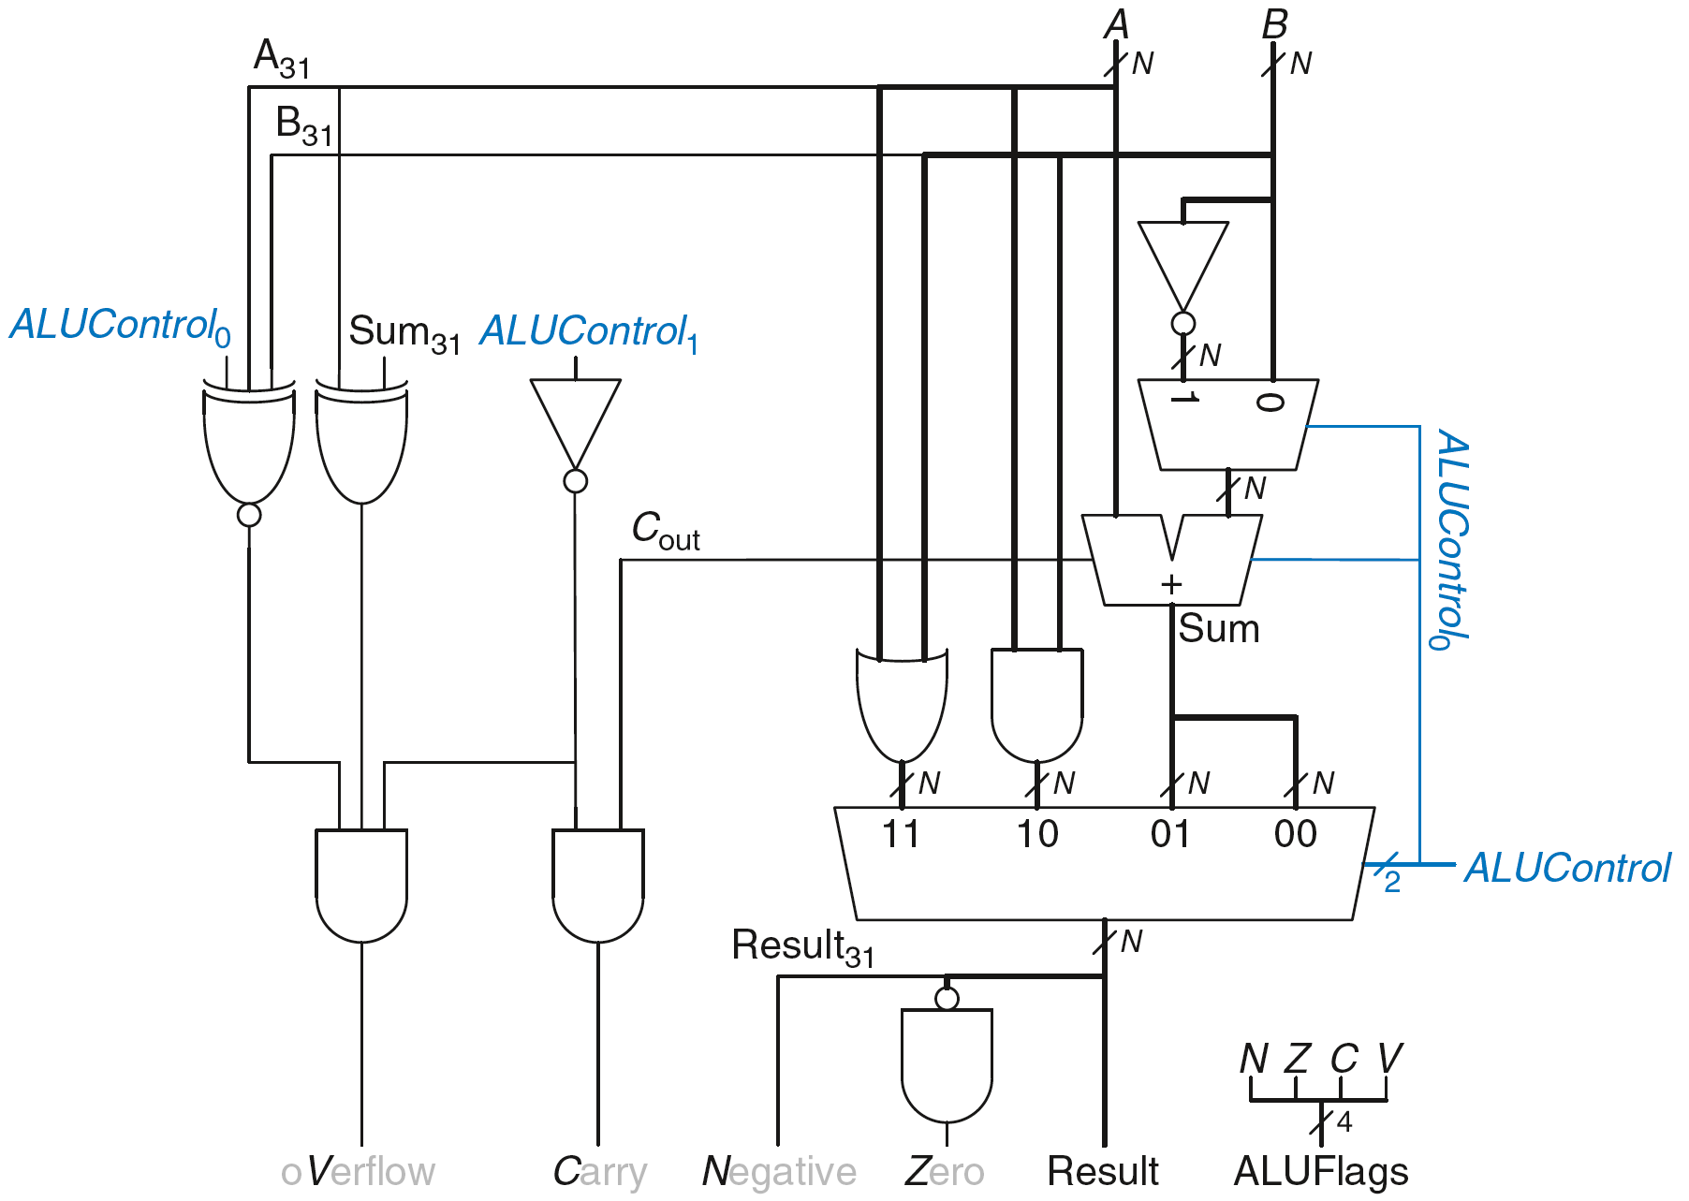
Review: ARM ALU

Slide 61
Setting the Condition Flags: NZCV
Method 1: Compare instruction: CMP
Example: CMP R5, R6
Performs: R5-R6
Does not save result
Sets flags. If result:
Is 0, Z=1
Is negative, N=1
Causes a carry out, C=1
Causes a signed overflow, V=1

Slide 62
Setting the Condition Flags: NZCV
Method 1: Compare instruction: CMP
Example: CMP R5, R6
Performs: R5-R6
Sets flags: If result is 0 (Z=1), negative (N=1), etc.
Does not save result
Method 2: Append instruction mnemonic with S
Example: ADDS R1, R2, R3
Performs: R2 + R3
Sets flags: If result is 0 (Z=1), negative (N=1), etc.
Saves result in R1

Slide 63
Condition Mnemonics
Instruction may be conditionally executed based on the condition flags
Condition of execution is encoded as a condition mnemonic appended to the instruction mnemonic
Example: CMP R1, R2
SUBNE R3, R5, R8
NE: not equal condition mnemonic
SUB will only execute if R1 ≠ R2
(i.e., Z = 0)

Slide 64
Condition Mnemonics

Slide 65
Condition Mnemonics
A ≥ B:
HS (CS): unsigned numbers. A – B will produce a carry out (C).
GE: signed numbers. A – B will make N and V either both 0 or both 1.

Slide 66
Condition Mnemonics
A ≥ B:
HS (CS): unsigned numbers. A – B will produce a carry out (C).
GE: signed numbers. A – B will make N and V either both 0 or both 1.

Slide 67
Conditional Execution
Example:
CMP R5, R9 ; performs R5-R9
; sets condition flags
SUBEQ R1, R2, R3 ; executes if R5==R9 (Z=1)
ORRMI R4, R0, R9 ; executes if R5-R9 is
; negative (N=1)
Suppose R5 = 17, R9 = 23:
CMP performs: 17 – 23 = -6 (Sets flags: N=1, Z=0, C=0, V=0)
SUBEQ doesn’t execute (they aren’t equal: Z=0)
ORRMI executes because the result was negative (N=1)

Slide 68
Programming Building Blocks
Data-processing Instructions
Conditional Execution
Branches
High-level Constructs:
if/else statements
for loops
while loops
arrays
function calls

Slide 69
Branching
Branches enable out of sequence instruction execution
Types of branches:
Branch (B)
branches to another instruction
Branch and link (BL)
discussed later
Both can be conditional or unconditional

Slide 70
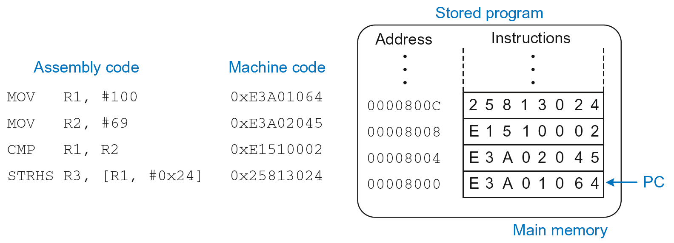
The Stored Program

Slide 71
Unconditional Branching (B)
ARM assembly
MOV R2, #17 ; R2 = 17
B TARGET ; branch to target
ORR R1, R1, #0x4 ; not executed
TARGET
SUB R1, R1, #78 ; R1 = R1 + 78
Labels (like TARGET) indicate instruction location. Labels can’t be reserved words (like ADD, ORR, etc.)

Slide 72
The Branch Not Taken
ARM Assembly
MOV R0, #4 ; R0 = 4
ADD R1, R0, R0 ; R1 = R0+R0 = 8
CMP R0, R1 ; sets flags with R0-R1
BEQ THERE ; branch not taken (Z=0)
ORR R1, R1, #1 ; R1 = R1 OR R1 = 9
THERE
ADD R1, R1, 78 ; R1 = R1 + 78 = 87

Slide 73
Programming Building Blocks
Data-processing Instructions
Conditional Execution
Branches
High-level Constructs:
if/else statements
for loops
while loops
arrays
function calls

Slide 74
if Statement
C Code
if (i == j)
f = g + h;
f = f – i;

Slide 75
if Statement
C Code
if (i == j)
f = g + h;
f = f – i;
ARM Assembly Code
;R0=f, R1=g, R2=h, R3=i, R4=j
CMP R3, R4 ; set flags with R3-R4
BNE L1 ; if i!=j, skip if block
ADD R0, R1, R2 ; f = g + h
L1
SUB R0, R0, R2 ; f = f - i

Slide 76
if Statement
C Code
if (i == j)
f = g + h;
f = f – i;
ARM Assembly Code
;R0=f, R1=g, R2=h, R3=i, R4=j
CMP R3, R4 ; set flags with R3-R4
BNE L1 ; if i!=j, skip if block
ADD R0, R1, R2 ; f = g + h
L1
SUB R0, R0, R2 ; f = f - i
Assembly tests opposite case (i != j) of high-level code (i == j)

Slide 77
if Statement: Alternate Code
C Code
if (i == j)
f = g + h;
f = f – i;
ARM Assembly Code
;R0=f, R1=g, R2=h, R3=i, R4=j
CMP R3, R4 ; set flags with R3-R4
ADDEQ R0, R1, R2 ; if (i==j) f = g + h
SUB R0, R0, R2 ; f = f - i

Slide 78
if Statement: Alternate Code
Alternate Assembly Code
;R0=f, R1=g, R2=h, R3=i, R4=j
CMP R3, R4 ; set flags with R3-R4
ADDEQ R0, R1, R2 ; if (i==j) f = g + h
SUB R0, R0, R2 ; f = f - i
Original
CMP R3, R4
BNE L1
ADD R0, R1, R2
L1
SUB R0, R0, R2

Slide 79
if Statement: Alternate Code
Alternate Assembly Code
;R0=f, R1=g, R2=h, R3=i, R4=j
CMP R3, R4 ; set flags with R3-R4
ADDEQ R0, R1, R2 ; if (i==j) f = g + h
SUB R0, R0, R2 ; f = f - i
Original
CMP R3, R4
BNE L1
ADD R0, R1, R2
L1
SUB R0, R0, R2
Useful for short conditional blocks of code

Slide 80
if/else Statement
C Code
if (i == j)
f = g + h;
else
f = f – i;
ARM Assembly Code

Slide 81
if/else Statement
C Code
if (i == j)
f = g + h;
else
f = f – i;
ARM Assembly Code
;R0=f, R1=g, R2=h, R3=i, R4=j
CMP R3, R4 ; set flags with R3-R4
BNE L1 ; if i!=j, skip if block
ADD R0, R1, R2 ; f = g + h
B L2 ; branch past else block
L1
SUB R0, R0, R2 ; f = f – i
L2

Slide 82
if/else Statement: Alternate Code
C Code
if (i == j)
f = g + h;
else
f = f – i;
ARM Assembly Code
;R0=f, R1=g, R2=h, R3=i, R4=j
CMP R3, R4 ; set flags with R3-R4
ADDEQ R0, R1, R2 ; if (i==j) f = g + h
SUBNE R0, R0, R2 ; else f = f - i

Slide 83
if/else Statement: Alternate Code
Original
CMP R3, R4
BNE L1
ADD R0, R1, R2
B L2
L1
SUB R0, R0, R2
L2
Alternate Assembly Code
;R0=f, R1=g, R2=h, R3=i, R4=j
CMP R3, R4 ; set flags with R3-R4
ADDEQ R0, R1, R2 ; if (i==j) f = g + h
SUBNE R0, R0, R2 ; else f = f - i

Slide 84
while Loops
C Code
// determines the power
// of x such that 2^{x} = 128
int pow = 1;
int x = 0;
while (pow != 128) {
pow = pow * 2;
x = x + 1;
}
ARM Assembly Code

Slide 85
while Loops
C Code
// determines the power
// of x such that 2^{x} = 128
int pow = 1;
int x = 0;
while (pow != 128) {
pow = pow * 2;
x = x + 1;
}
ARM Assembly Code
; R0 = pow, R1 = x
MOV R0, #1 ; pow = 1
MOV R1, #0 ; x = 0
WHILE
CMP R0, #128 ; R0-128
BEQ DONE ; if (pow==128) ; exit loop
LSL R0, R0, #1 ; pow=pow*2
ADD R1, R1, #1 ; x=x+1
B WHILE ; repeat loop
DONE

Slide 86
while Loops
C Code
// determines the power
// of x such that 2^{x} = 128
int pow = 1;
int x = 0;
while (pow != 128) {
pow = pow * 2;
x = x + 1;
}
ARM Assembly Code
; R0 = pow, R1 = x
MOV R0, #1 ; pow = 1
MOV R1, #0 ; x = 0
WHILE
CMP R0, #128 ; R0-128
BEQ DONE ; if (pow==128) ; exit loop
LSL R0, R0, #1 ; pow=pow*2
ADD R1, R1, #1 ; x=x+1
B WHILE ; repeat loop
DONE
Assembly tests for the opposite case (pow == 128) of the C code (pow != 128).

Slide 87
for Loops
for (initialization; condition; loop operation)
statement
initialization: executes before the loop begins
condition: is tested at the beginning of each iteration
loop operation: executes at the end of each iteration
statement: executes each time the condition is met

Slide 88
for Loops
C Code
// adds numbers from 1-9
int sum = 0;
int i;
for (i=1; i!=10; i=i+1)
sum = sum + i;
ARM Assembly Code

Slide 89
for Loops
C Code
// adds numbers from 1-9
int sum = 0
for (i=1; i!=10; i=i+1)
sum = sum + i;
ARM Assembly Code
; R0 = i, R1 = sum
MOV R0, #1 ; i = 1
MOV R1, #0 ; sum = 0
FOR
CMP R0, #10 ; R0-10
BEQ DONE ; if (i==10) ; exit loop
ADD R1, R1, R0 ; sum=sum + i
ADD R0, R0, #1 ; i = i + 1
B FOR ; repeat loop
DONE

Slide 90
for Loops: Decremented Loops
In ARM, decremented loop variables are more efficient

Slide 91
for Loops: Decremented Loops
In ARM, decremented loop variables are more efficient
C Code
// adds numbers from 1-9
int sum = 0
for (i=9; i!=0; i=i-1)
sum = sum + i;
ARM Assembly Code
; R0 = i, R1 = sum
MOV R0, #9 ; i = 9
MOV R1, #0 ; sum = 0
FOR
ADD R1, R1, R0 ; sum=sum + i
SUBS R0, R0, #1 ; i = i – 1
; and set flags
BNE FOR ; if (i!=0) ; repeat loop

Slide 92
for Loops: Decremented Loops
In ARM, decremented loop variables are more efficient
C Code
// adds numbers from 1-9
int sum = 0
for (i=9; i!=0; i=i-1)
sum = sum + i;
ARM Assembly Code
; R0 = i, R1 = sum
MOV R0, #9 ; i = 9
MOV R1, #0 ; sum = 0
FOR
ADD R1, R1, R0 ; sum=sum + i
SUBS R0, R0, #1 ; i = i – 1
; and set flags
BNE FOR ; if (i!=0) ; repeat loop
Saves 2 instructions per iteration:
Decrement loop variable & compare: SUBS R0, R0, #1
Only 1 branch – instead of 2

Slide 93
Programming Building Blocks
Data-processing Instructions
Conditional Execution
Branches
High-level Constructs:
if/else statements
for loops
while loops
arrays
function calls

Slide 94
Arrays
Access large amounts of similar data
Index: access to each element
Size: number of elements

Slide 95
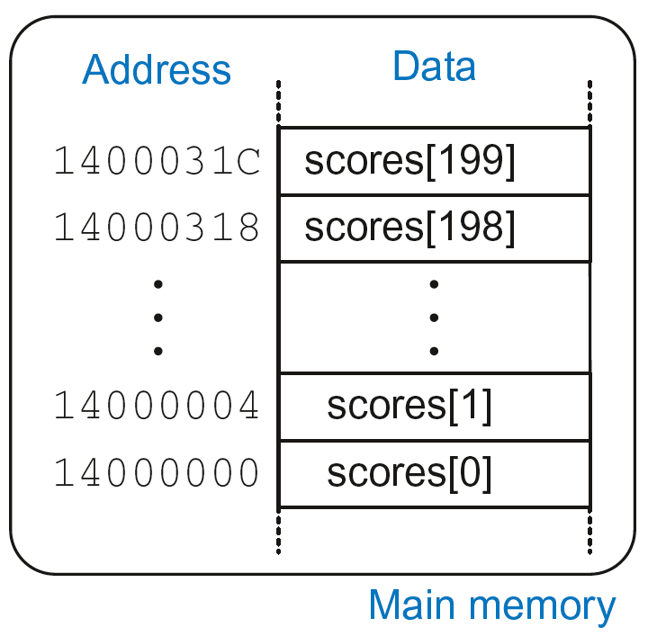
Arrays
200-element array
Base address = 0x14000000 (address of first element, scores[0])
Array elements accessed relative to base address

Slide 96
Accessing Arrays
C Code
int array[200];
array[0] = array[0] * 8;
array[1] = array[1] * 8;
ARM Assembly Code
; R0 = array base address

Slide 97
Accessing Arrays
C Code
int array[5];
array[0] = array[0] * 8;
array[1] = array[1] * 8;
ARM Assembly Code
; R0 = array base address
MOV R0, #0x60000000 ; R0 = 0x60000000
LDR R1, [R0] ; R1 = array[0]
LSL R1, R1, 3 ; R1 = R1 << 3 = R1*8
STR R1, [R0] ; array[0] = R1
LDR R1, [R0, #4] ; R1 = array[1]
LSL R1, R1, 3 ; R1 = R1 << 3 = R1*8
STR R1, [R0, #4] ; array[1] = R1

Slide 98
Arrays using for Loops
C Code
int array[200];
int i;
for (i=199; i >= 0; i = i - 1)
array[i] = array[i] * 8;
ARM Assembly Code
; R0 = array base address, R1 = i

Slide 99
Arrays using for Loops
C Code
int array[200];
int i;
for (i=199; i >= 0; i = i - 1)
array[i] = array[i] * 8;
ARM Assembly Code
; R0 = array base address, R1 = i
MOV R0, 0x60000000
MOV R1, #199
FOR
LDR R2, [R0, R1, LSL #2] ; R2 = array(i)
LSL R2, R2, #3 ; R2 = R2<<3 = R3*8
STR R2, [R0, R1, LSL #2] ; array(i) = R2
SUBS R1, R1, #1 ; i = i – 1
; and set flags
BPL FOR ; if (i>=0) repeat loop

Slide 100
ASCII Code
American Standard Code for Information Interchange
Each text character has unique byte value
For example, S = 0x53, a = 0x61, A = 0x41
Lower-case and upper-case differ by 0x20 (32)

Slide 101
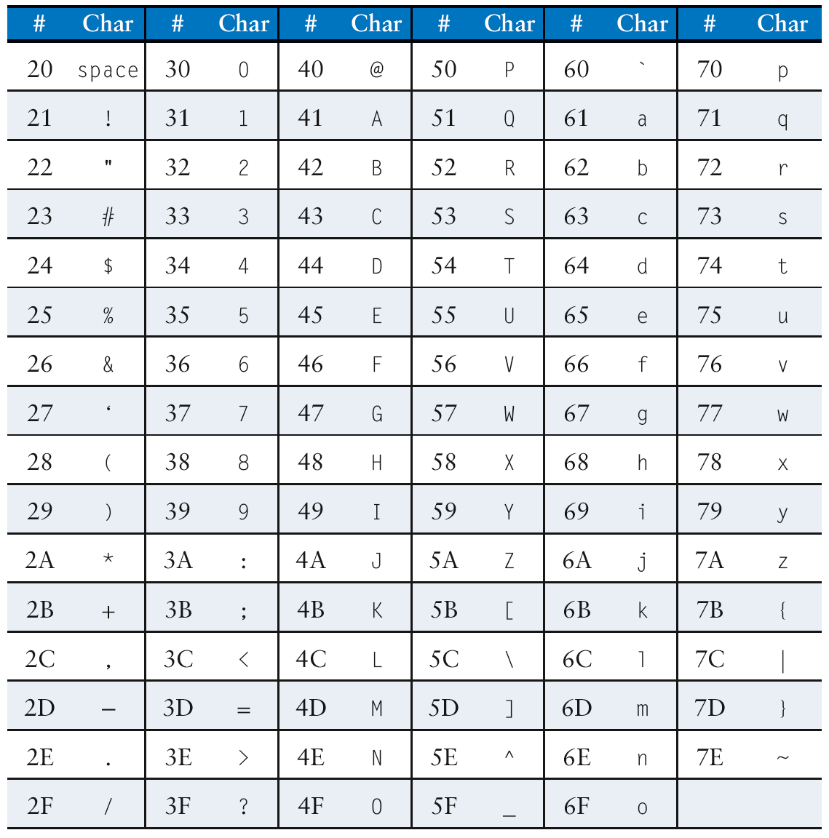
Cast of Characters

Slide 102
Programming Building Blocks
Data-processing Instructions
Conditional Execution
Branches
High-level Constructs:
if/else statements
for loops
while loops
arrays
function calls

Slide 103
Function Calls
Caller: calling function (in this case, main)
Callee: called function (in this case, sum)
C Code
void main()
{
int y;
y = sum(42, 7);
...
}
int sum(int a, int b)
{
return (a + b);
}

Slide 104
Function Conventions
Caller:
passes arguments to callee
jumps to callee

Slide 105
Function Conventions
Caller:
passes arguments to callee
jumps to callee
Callee:
performs the function
returns result to caller
returns to point of call
must not overwrite registers or memory needed by caller

Slide 106
ARM Function Conventions
Call Function: branch and link
BL
Return from function: move the link register to PC: MOV PC, LR
Arguments: R0-R3
Return value: R0

Slide 107
Function Calls
C Code
int main() {
simple();
a = b + c;
}
void simple() {
return;
}
ARM Assembly Code
0x00000200 MAIN BL SIMPLE
0x00000204 ADD R4, R5, R6
...
0x00401020 SIMPLE MOV PC, LR
void means that simple doesn’t return a value

Slide 108
Function Calls
C Code
int main() {
simple();
a = b + c;
}
void simple() {
return;
}
ARM Assembly Code
0x00000200 MAIN BL SIMPLE
0x00000204 ADD R4, R5, R6
...
0x00401020 SIMPLE MOV PC, LR
BL branches to SIMPLE
LR = PC + 4 = 0x00000204
MOV PC, LR makes PC = LR
(the next instruction executed is at 0x00000200)

Slide 109
Input Arguments and Return Value
ARM conventions:
Argument values: R0 - R3
Return value: R0

Slide 110
Input Arguments and Return Value
C Code
int main()
{
int y;
...
y = diffofsums(2, 3, 4, 5); // 4 arguments
...
}
int diffofsums(int f, int g, int h, int i)
{
int result;
result = (f + g) - (h + i);
return result; // return value
}

Slide 111
Input Arguments and Return Value
ARM Assembly Code
; R4 = y
MAIN
...
MOV R0, #2 ; argument 0 = 2
MOV R1, #3 ; argument 1 = 3
MOV R2, #4 ; argument 2 = 4
MOV R3, #5 ; argument 3 = 5
BL DIFFOFSUMS ; call function
MOV R4, R0 ; y = returned value
...
; R4 = result
DIFFOFSUMS
ADD R8, R0, R1 ; R8 = f + g
ADD R9, R2, R3 ; R9 = h + i
SUB R4, R8, R9 ; result = (f + g) - (h + i)
MOV R0, R4 ; put return value in R0
MOV PC, LR ; return to caller

Slide 112
Input Arguments and Return Value
ARM Assembly Code
; R4 = result
DIFFOFSUMS
ADD R8, R0, R1 ; R8 = f + g
ADD R9, R2, R3 ; R9 = h + i
SUB R4, R8, R9 ; result = (f + g) - (h + i)
MOV R0, R4 ; put return value in R0
MOV PC, LR ; return to caller
diffofsums overwrote 3 registers: R4, R8, R9
diffofsums can use stack to temporarily store registers

Slide 113

The Stack
Memory used to temporarily save variables
Like stack of dishes, last-in-first-out (LIFO) queue
Expands: uses more memory when more space needed
Contracts: uses less memory when the space no longer needed

Slide 114
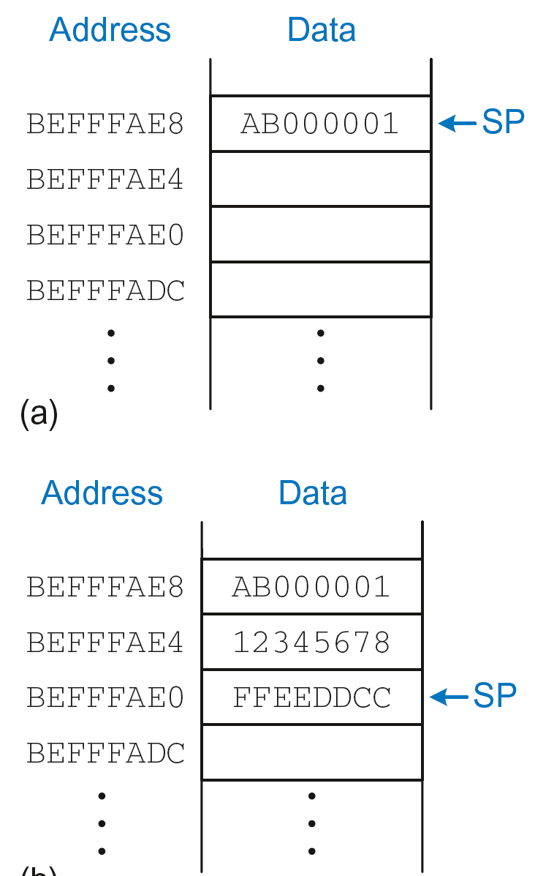
The Stack
Grows down (from higher to lower memory addresses)
Stack pointer: SP points to top of the stack
Stack expands by 2 words

Slide 115
How Functions use the Stack
Called functions must have no unintended side effects
But diffofsums overwrites 3 registers: R4, R8, R9
ARM Assembly Code
; R4 = result
DIFFOFSUMS
ADD R8, R0, R1 ; R8 = f + g
ADD R9, R2, R3 ; R9 = h + i
SUB R4, R8, R9 ; result = (f + g) - (h + i)
MOV R0, R4 ; put return value in R0
MOV PC, LR ; return to caller

Slide 116
Storing Register Values on the Stack
ARM Assembly Code
; R2 = result
DIFFOFSUMS
SUB SP, SP, #12 ; make space on stack for 3 registers
STR R9, [SP, #8] ; save R9 on stack
STR R8, [SP, #4] ; save R8 on stack
STR R4, [SP] ; save R4 on stack
ADD R8, R0, R1 ; R8 = f + g
ADD R9, R2, R3 ; R9 = h + i
SUB R4, R8, R9 ; result = (f + g) - (h + i)
MOV R0, R4 ; put return value in R0
LDR R4, [SP] ; restore R4 from stack
LDR R8, [SP, #4] ; restore R8 from stack
LDR R9, [SP, #8] ; restore R9 from stack
ADD SP, SP, #12 ; deallocate stack space
MOV PC, LR ; return to caller

Slide 117
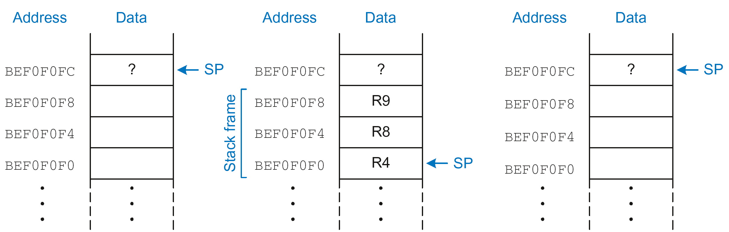
The Stack during diffofsums Call
Before call
During call
After call

Slide 118
Registers
Preserved Callee-Saved | Nonpreserved Caller-Saved
R4-R11 | R12
R14 (LR) | R0-R3
R13 (SP) | CPSR
stack above SP | stack below SP

Slide 119
Storing Saved Registers only on Stack
ARM Assembly Code
; R2 = result
DIFFOFSUMS
STR R4, [SP, #-4]! ; save R4 on stack -> SP-4 (Pre-index)
ADD R8, R0, R1 ; R8 = f + g
ADD R9, R2, R3 ; R9 = h + i
SUB R4, R8, R9 ; result = (f + g) - (h + i)
MOV R0, R4 ; put return value in R0
LDR R4, [SP], #4 ; restore R4 from stack -> SP (Post-index)
MOV PC, LR ; return to caller

Slide 120
Storing Saved Registers only on Stack
ARM Assembly Code
; R2 = result
DIFFOFSUMS
STR R4, [SP, #-4]! ; save R4 on stack
ADD R8, R0, R1 ; R8 = f + g
ADD R9, R2, R3 ; R9 = h + i
SUB R4, R8, R9 ; result = (f + g) - (h + i)
MOV R0, R4 ; put return value in R0
LDR R4, [SP], #4 ; restore R4 from stack
MOV PC, LR ; return to caller
Notice code optimization for expanding/contracting stack

Slide 121
Nonleaf Function
ARM Assembly Code
STR LR, [SP, #-4]! ; store LR on stack
BL PROC2 ; call another function
...
LDR LR, [SP], #4 ; restore LR from stack
MOV PC, LR ; return to caller

Slide 122
Nonleaf Function Example
C Code
int f1(int a, int b) {
int i, x;
x = (a + b)*(a − b);
for (i=0; i<a; i++)
x = x + f2(b+i);
return x;
}
int f2(int p) {
int r;
r = p + 5;
return r + p;
}

Slide 123
Nonleaf Function Example
C Code
int f1(int a, int b) {
int i, x;
x = (a + b)*(a − b);
for (i=0; i<a; i++)
x = x + f2(b+i);
return x;
}
int f2(int p) {
int r;
r = p + 5;
return r + p;
}
ARM Assembly Code
; R0=a, R1=b, R4=i, R5=x
F1
PUSH {R4, R5, LR}
ADD R5, R0, R1
SUB R12, R0, R1
MUL R5, R5, R12
MOV R4, #0
FOR
CMP R4, R0
BGE RETURN
PUSH {R0, R1}
ADD R0, R1, R4
BL F2
ADD R5, R5, R0
POP {R0, R1}
ADD R4, R4, #1
B FOR
RETURN
MOV R0, R5
POP {R4, R5, LR}
MOV PC, LR

Slide 124
Nonleaf Function Example
C Code
int f1(int a, int b) {
int i, x;
x = (a + b)*(a − b);
for (i=0; i<a; i++)
x = x + f2(b+i);
return x;
}
int f2(int p) {
int r;
r = p + 5;
return r + p;
}
ARM Assembly Code
; R0=a, R1=b, R4=i, R5=x
F1
PUSH {R4, R5, LR}
ADD R5, R0, R1
SUB R12, R0, R1
MUL R5, R5, R12
MOV R4, #0
FOR
CMP R4, R0
BGE RETURN
PUSH {R0, R1}
ADD R0, R1, R4
BL F2
ADD R5, R5, R0
POP {R0, R1}
ADD R4, R4, #1
B FOR
RETURN
MOV R0, R5
POP {R4, R5, LR}
MOV PC, LR
; R0=p, R4=r
F2
PUSH {R4}
ADD R4, R0, 5
ADD R0, R4, R0
POP {R4}
MOV PC, LR

Slide 125
Nonleaf Function Example
ARM Assembly Code
; R0=a, R1=b, R4=i, R5=x
F1
PUSH {R4, R5, LR} ; save regs
ADD R5, R0, R1 ; x = (a+b)
SUB R12, R0, R1 ; temp = (a-b)
MUL R5, R5, R12 ; x = x*temp
MOV R4, #0 ; i = 0
FOR
CMP R4, R0 ; i < a?
BGE RETURN ; no: exit loop
PUSH {R0, R1} ; save regs
ADD R0, R1, R4 ; arg is b+i
BL F2 ; call f2(b+i)
ADD R5, R5, R0 ; x = x+f2(b+i)
POP {R0, R1} ; restore regs
ADD R4, R4, #1 ; i++
B FOR ; repeat loop
RETURN
MOV R0, R5 ; return x
POP {R4, R5, LR} ; restore regs
MOV PC, LR ; return
; R0=p, R4=r
F2
PUSH {R4} ; save regs
ADD R4, R0, 5 ; r = p+5
ADD R0, R4, R0 ; return r+p
POP {R4} ; restore regs
MOV PC, LR ; return

Slide 126
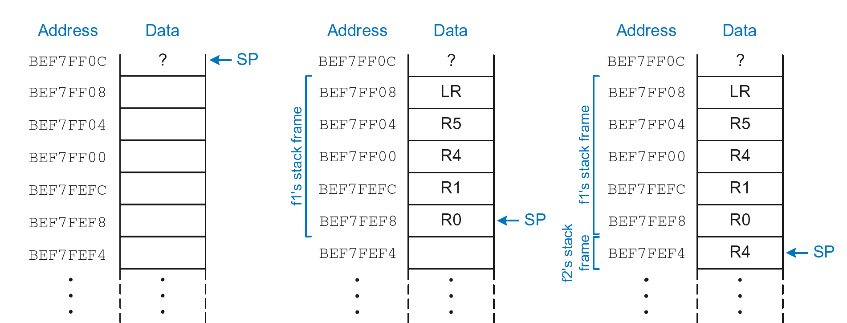
Stack during Nonleaf Function
At beginning of f1
Just before calling f2
After calling f2

Slide 127
Recursive Function Call
C Code
int factorial(int n) {
if (n <= 1)
return 1;
else
return (n * factorial(n-1));
}

Slide 128
Recursive Function Call
ARM Assembly Code

Slide 129
Recursive Function Call
ARM Assembly Code
0x8500 FACTOR PUSH {R0, LR} ; push n and LR on stack
0x8504 CMP R0,#1 ; R0<=1?
0x8508 BGT ELSE ; yes: branch to ELSE
0x850C MOV R0, #1 ; otherwise, return 1
0x8510 ADD SP, SP, #8 ; restore SP
0x8514 MOV PC, LR ; return
0x8518 ELSE SUB R0, R0, #1 ; n=n−1
0x851C BL FACTOR ; recursive call
0x8520 POP {R1, LR} ; pop n (into R1) and LR
0x8524 MUL R0, R1, R0 ; R0 = n * factorial(n − 1)
0x8528 MOV PC, LR ; return

Slide 130
Recursive Function Call
ARM Assembly Code: LR_{main}, R0 (n=3). 1st call
0x8500 FACTOR PUSH {3, LR_{main}} ; push n=3 and LR_{main} on stack
0x8504 CMP R0,#1 ; 3<=1? -> 3-1=2 -> GT
0x8508 BGT ELSE ; yes: branch to ELSE
0x850C MOV R0, #1 ; otherwise, return 1
0x8510 ADD SP, SP, #8 ; restore SP
0x8514 MOV PC, LR ; return
0x8518 ELSE SUB R0, R0, #1 ; n = 3−1 -> R0=2
0x851C BL FACTOR ; recursive call -> LR = 0x8520
0x8520 POP {R1, LR} ; pop n (into R1) and LR
0x8524 MUL R0, R1, R0 ; R0 = n * factorial(n − 1)
0x8528 MOV PC, LR ; return

Slide 131
Recursive Function Call
ARM Assembly Code: LR_{(0x8520)}, R0 (n=2). 2nd call
0x8500 FACTOR PUSH {2, LR_{(0x8520)}}; push n=2 and LR_{(0x8520)} stack
0x8504 CMP R0,#1 ; 2<=1? -> 2-1=1 -> GT
0x8508 BGT ELSE ; yes: branch to ELSE
0x850C MOV R0, #1 ; otherwise, return 1
0x8510 ADD SP, SP, #8 ; restore SP
0x8514 MOV PC, LR ; return
0x8518 ELSE SUB R0, R0, #1 ; n = 2−1 -> R0=1
0x851C BL FACTOR ; recursive call -> LR = 0x8520
0x8520 POP {R1, LR} ; pop n (into R1) and LR
0x8524 MUL R0, R1, R0 ; R0 = n * factorial(n − 1)
0x8528 MOV PC, LR ; return

Slide 132
Recursive Function Call
ARM Assembly Code: LR_{(0x8520)}, R0 (n=1). 3rd call
0x8500 FACTOR PUSH {1, LR_{(0x8520)}}; push n=1 and LR_{(0x8520)} stack
0x8504 CMP R0,#1 ; 1<=1? -> 1-1=0 -> not GT
0x8508 BGT ELSE ; no: continue with next instruction
0x850C MOV R0, #1 ; otherwise, return R0=1 (n=1)
0x8510 ADD SP, SP, #8 ; restore SP (delete PUSH {1, LR_{(0x8520)}})
0x8514 MOV PC, LR ; return to PC=LR_{(0x8520)}
0x8518 ELSE SUB R0, R0, #1 ; n = 2−1 -> R0=1
0x851C BL FACTOR ; recursive call -> LR = 0x8520
0x8520 POP {R1, LR} ; pop n (into R1) and LR
0x8524 MUL R0, R1, R0 ; R0 = n * factorial(n − 1)
0x8528 MOV PC, LR ; return

Slide 133
Recursive Function Call
ARM Assembly Code: 1st return
0x8500 FACTOR PUSH {1, LR_{(0x8520)}}; push n=1 and LR_{(0x8520)} stack
0x8504 CMP R0,#1 ; 1<=1? -> 1-1=0 -> not GT
0x8508 BGT ELSE ; no: continue with next instruction
0x850C MOV R0, #1 ; otherwise, return R0=1 (n=1)
0x8510 ADD SP, SP, #8 ; restore SP (delete PUSH {1, LR_{(0x8520)}})
0x8514 MOV PC, LR ; return to PC=LR_{(0x8520)}
0x8518 ELSE SUB R0, R0, #1 ; n = 2−1 -> R0=1
0x851C BL FACTOR ; recursive call -> LR = 0x8520
0x8520 POP {R1, LR} ; pop R1=2 (n) and LR=0x8520
0x8524 MUL R0, R1, R0 ; R0 = 2 * 1 = 2
0x8528 MOV PC, LR ; return to PC=LR_{(0x8520)}

Slide 134
Recursive Function Call
ARM Assembly Code: 2nd return
0x8500 FACTOR PUSH {1, LR_{(0x8520)}}; push n=1 and LR_{(0x8520)} stack
0x8504 CMP R0,#1 ; 1<=1? -> 1-1=0 -> not GT
0x8508 BGT ELSE ; no: continue with next instruction
0x850C MOV R0, #1 ; otherwise, return R0=1 (n=1)
0x8510 ADD SP, SP, #8 ; restore SP (delete PUSH {1, LR_{(0x8520)}})
0x8514 MOV PC, LR ; return to PC=LR_{(0x8520)}
0x8518 ELSE SUB R0, R0, #1 ; n = 2−1 -> R0=1
0x851C BL FACTOR ; recursive call -> LR = 0x8520
0x8520 POP {R1, LR} ; pop R1=3 (n) and LR=main
0x8524 MUL R0, R1, R0 ; R0 = 3 * 2 = 6
0x8528 MOV PC, LR ; return to PC=LR_{main}

Slide 135
Stack during Recursive Call
Before call
During call
After call

Slide 136
Function Call Summary
Caller
Puts arguments in R0-R3
Saves any needed registers (LR, maybe R0-R3, R8-R12)
Calls function: BL CALLEE
Restores registers
Looks for result in R0
Callee
Saves registers that might be disturbed (R4-R7)
Performs function
Puts result in R0
Restores registers
Returns: MOV PC, LR

Slide 137
How to Encode Instructions?

Slide 138
How to Encode Instructions?
Design Principle 1: Regularity supports design simplicity
32-bit data, 32-bit instructions
For design simplicity, would prefer a single instruction format but…

Slide 139
How to Encode Instructions?
Design Principle 1: Regularity supports design simplicity
32-bit data, 32-bit instructions
For design simplicity, would prefer a single instruction format but…
Instructions have different needs

Slide 140
Design Principle 4
Good design demands good compromises
Multiple instruction formats allow flexibility
ADD, SUB: use 3 register operands
LDR, STR: use 2 register operands and a constant
Number of instruction formats kept small
to adhere to design principles 1 and 3 (regularity supports design simplicity and smaller is faster)

Slide 141
Machine Language
Binary representation of instructions
Computers only understand 1’s and 0’s
32-bit instructions
Simplicity favors regularity: 32-bit data & instructions
3 instruction formats:
Data-processing
Memory
Branch

Slide 142
Instruction Formats
Data-processing
Memory
Branch

Slide 143
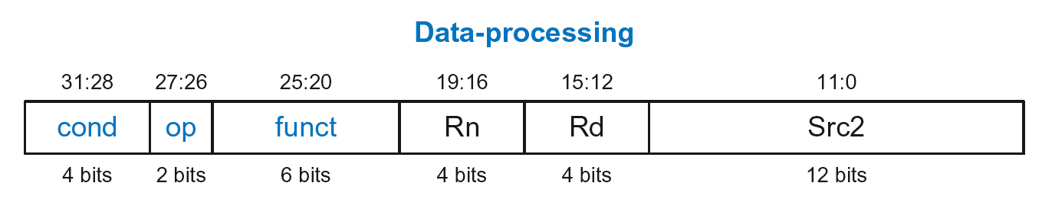
Data-processing Instruction Format
Operands:
Rn: first source register
Src2: second source – register or immediate
Rd: destination register
Control fields:
cond: specifies conditional execution
op: the operation code or opcode
funct: the function/operation to perform

Slide 144
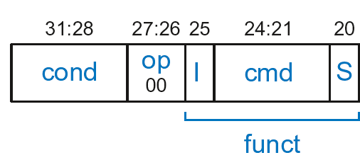
Data-processing Control Fields
op = 00₂ for data-processing (DP) instructions
funct is composed of cmd, I-bit, and S-bit

Slide 145
Data-processing Control Fields
op = 00₂ for data-processing (DP) instructions
funct is composed of cmd, I-bit, and S-bit
cmd: specifies the specific data-processing instruction. For example,
cmd = 0100₂ for ADD
cmd = 0010₂ for SUB
I-bit
I = 0: Src2 is a register
I = 1: Src2 is an immediate
S-bit: 1 if sets condition flags
S = 0: SUB R0, R5, R7
S = 1: ADDS R8, R2, R4 or CMP R3, #10

Slide 146
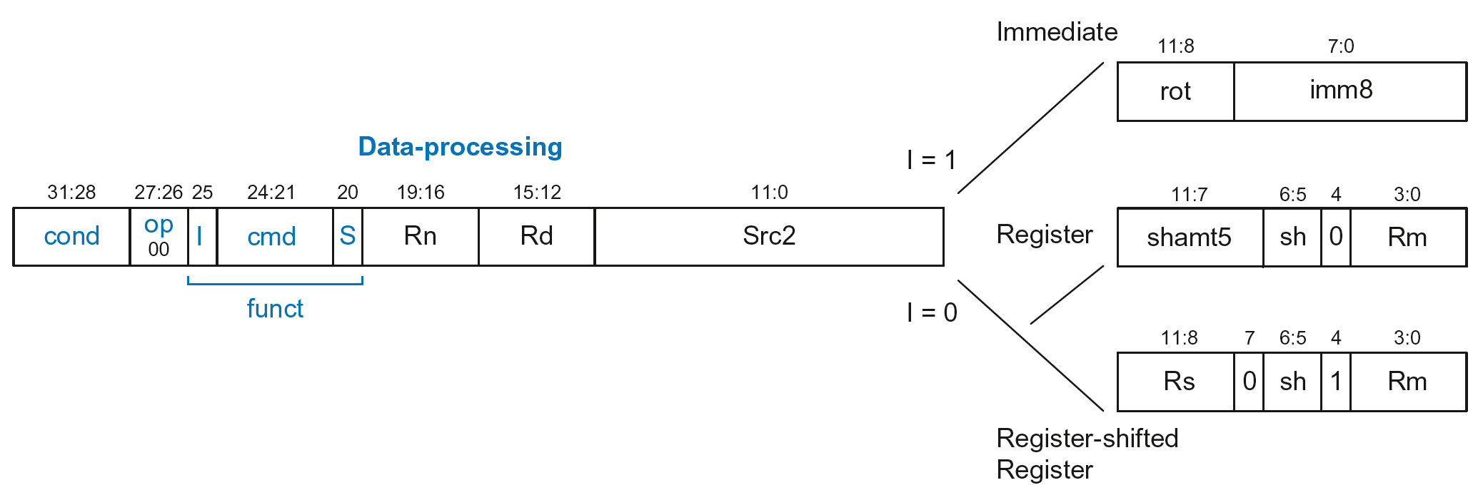
Data-processing Src2 Variations
Src2 can be:
Immediate
Register
Register-shifted register

Slide 147
Data-processing Src2 Variations
Src2 can be:
Immediate
Register
Register-shifted register

Slide 148
Immediate Src2
Immediate encoded as:
imm8: 8-bit unsigned immediate
rot: 4-bit rotation value
32-bit constant is: imm8 ROR (rot × 2)

Slide 149
Immediate Src2
Immediate encoded as:
imm8: 8-bit unsigned immediate
rot: 4-bit rotation value
32-bit constant is: imm8 ROR (rot × 2)
Example: imm8 = abcdefgh
rot | 32-bit constant
0000 | 0000 0000 0000 0000 0000 0000 abcd efgh
0001 | gh00 0000 0000 0000 0000 0000 00ab cdef
… | …
1111 | 0000 0000 0000 0000 0000 00ab cdef gh00

Slide 150
Immediate Src2
Immediate encoded as:
imm8: 8-bit unsigned immediate
rot: 4-bit rotation value
32-bit constant is: imm8 ROR (rot × 2)
Example: imm8 = abcdefgh
ROR by X = ROL by (32-X)
Ex: ROR by 30 = ROL by 2
rot | 32-bit constant
0000 | 0000 0000 0000 0000 0000 0000 abcd efgh
0001 | gh00 0000 0000 0000 0000 0000 00ab cdef
… | …
1111 | 0000 0000 0000 0000 0000 00ab cdef gh00

Slide 151
DP Instruction with Immediate Src2
ADD R0, R1, #42
cond = 1110₂ (14) for unconditional execution
op = 00₂ (0) for data-processing instructions
cmd = 0100₂ (4) for ADD
Src2 is an immediate so I = 1
Rd = 0, Rn = 1
imm8 = 42, rot = 0

Slide 152
DP Instruction with Immediate Src2
ADD R0, R1, #42
cond = 1110₂ (14) for unconditional execution
op = 00₂ (0) for data-processing instructions
cmd = 0100₂ (4) for ADD
Src2 is an immediate so I = 1
Rd = 0, Rn = 1
imm8 = 42, rot = 0
0xE281002A

Slide 153
DP Instruction with Immediate Src2
SUB R2, R3, #0xFF0
cond = 1110₂ (14) for unconditional execution
op = 00₂ (0) for data-processing instructions
cmd = 0010₂ (2) for SUB
Src2 is an immediate so I=1
Rd = 2, Rn = 3
imm8 = 0xFF
imm8 must be rotated right by 28 to produce 0xFF0, so rot = 14
ROR by 28 =
ROL by (32-28) = 4
0xE2432EFF

Slide 154
DP Instruction with Register Src2
Src2 can be:
Immediate
Register
Register-shifted register

Slide 155
DP Instruction with Register Src2
Rm: the second source operand
shamt5: the amount Rm is shifted
sh: the type of shift (i.e., >>, <<, >>>, ROR)

Slide 156
DP Instruction with Register Src2
Rm: the second source operand
shamt5: the amount Rm is shifted
sh: the type of shift (i.e., >>, <<, >>>, ROR)
First, consider unshifted versions of Rm (shamt5=0, sh=0)

Slide 157
DP Instruction with Register Src2
ADD R5, R6, R7
cond = 1110₂ (14) for unconditional execution
op = 00₂ (0) for data-processing instructions
cmd = 0100₂ (4) for ADD
Src2 is a register so I=0
Rd = 5, Rn = 6, Rm = 7
shamt = 0, sh = 0
0xE0865007

Slide 158
DP Instruction with Register Src2
Rm: the second source operand
shamt5: the amount Rm is shifted
sh: the type of shift
Shift Type | sh
LSL | 00₂
LSR | 01₂
ASR | 10₂
ROR | 11₂
Now, consider shifted versions.

Slide 159
DP Instruction with Register Src2
ORR R9, R5, R3, LSR #2
Operation: R9 = R5 OR (R3 >> 2)
cond = 1110₂ (14) for unconditional execution
op = 00₂ (0) for data-processing instructions
cmd = 1100₂ (12) for ORR
Src2 is a register so I=0
Rd = 9, Rn = 5, Rm = 3
shamt5 = 2, sh = 01₂ (LSR)
1110 00 0 1100 0 0101 1001 00010 01 0 0011
0xE1859123

Slide 160
DP with Register-shifted Reg. Src2
Src2 can be:
Immediate
Register
Register-shifted register

Slide 161
DP with Register-shifted Reg. Src2
EOR R8, R9, R10, ROR R12
Operation: R8 = R9 XOR (R10 ROR R12)
cond = 1110₂ (14) for unconditional execution
op = 00₂ (0) for data-processing instructions
cmd = 0001₂ (1) for EOR
Src2 is a register so I=0
Rd = 8, Rn = 9, Rm = 10, Rs = 12
sh = 11₂ (ROR)
1110 00 0 0001 0 1001 1000 1100 0 11 1 1010
0xE0298C7A

Slide 162
Shift Instructions Encoding
Shift Type | sh
LSL | 00₂
LSR | 01₂
ASR | 10₂
ROR | 11₂

Slide 163
Shift Instructions: Immediate shamt
ROR R1, R2, #23
Operation: R1 = R2 ROR 23
cond = 1110₂ (14) for unconditional execution
op = 00₂ (0) for data-processing instructions
cmd = 1101₂ (13) for all shifts (LSL, LSR, ASR, and ROR)
Src2 is an immediate-shifted register so I=0
Rd = 1, Rn = 0, Rm = 2
shamt5 = 23, sh = 11₂ (ROR)
1110 00 0 1101 0 0000 0001 10111 11 0 0010
0xE1A01BE2

Slide 164
Shift Instructions: Immediate shamt
ROR R1, R2, #23
Operation: R1 = R2 ROR 23
cond = 1110₂ (14) for unconditional execution
op = 00₂ (0) for data-processing instructions
cmd = 1101₂ (13) for all shifts (LSL, LSR, ASR, and ROR)
Src2 is an immediate-shifted register so I=0
Rd = 1, Rn = 0, Rm = 2
shamt5 = 23, sh = 11₂ (ROR)
Uses (immediate-shifted) register Src2 encoding
1110 00 0 1101 0 0000 0001 10111 11 0 0010
0xE1A01BE2

Slide 165
Shift Instructions: Register shamt
ASR R5, R6, R10
Operation: R5 = R6 >>> R10_{7:0}
cond = 1110₂ (14) for unconditional execution
op = 00₂ (0) for data-processing instructions
cmd = 1101₂ (13) for all shifts (LSL, LSR, ASR, and ROR)
Src2 is a register so I=0
Rd = 5, Rn = 0, Rm = 6, Rs = 10
sh = 10₂ (ASR)
1110 00 0 1101 0 0000 0101 1010 0 10 1 0110
0xE1A05A56

Slide 166
Shift Instructions: Register shamt
ASR R5, R6, R10
Operation: R5 = R6 >>> R10_{7:0}
cond = 1110₂ (14) for unconditional execution
op = 00₂ (0) for data-processing instructions
cmd = 1101₂ (13) for all shifts (LSL, LSR, ASR, and ROR)
Src2 is a register so I=0
Rd = 5, Rn = 0, Rm = 6, Rs = 10
sh = 10₂ (ASR)
Uses register-shifted register Src2 encoding
1110 00 0 1101 0 0000 0101 1010 0 10 1 0110
0xE1A05A56

Slide 167
Review: Data-processing Format
Src2 can be:
Immediate
Register
Register-shifted register

Slide 168
Instruction Formats
Data-processing
Memory
Branch

Slide 169
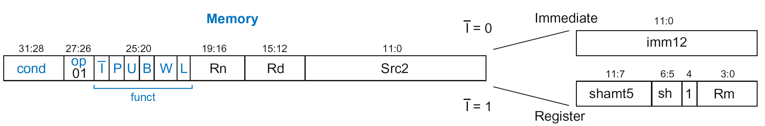
Memory Instruction Format
Encodes: LDR, STR, LDRB, STRB
op = 01₂
Rn = base register
Rd = destination (load), source (store)
Src2 = offset
funct = 6 control bits

Slide 170
Offset Options
Recall: Address = Base Address + Offset
Example: LDR R1, [R2, #4]
Base Address = R2, Offset = 4
Address = (R2 + 4)
Base address always in a register
The offset can be:
an immediate
a register
or a scaled (shifted) register

Slide 171
Offset Examples
ARM Assembly | Memory Address
LDR R0, [R3, #4] | R3 + 4
LDR R0, [R5, #-16] | R5 – 16
LDR R1, [R6, R7] | R6 + R7
LDR R2, [R8, -R9] | R8 – R9
LDR R3, [R10, R11, LSL #2] | R10 + (R11 << 2)
LDR R4, [R1, -R12, ASR #4] | R1 – (R12 >>> 4)
LDR R0, [R9] | R9

Slide 172
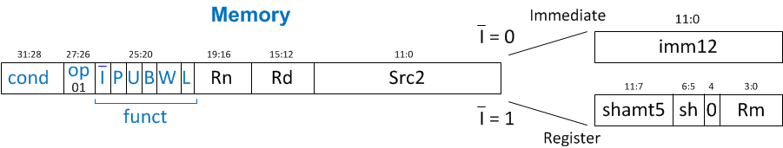
Memory Instruction Format
Encodes: LDR, STR, LDRB, STRB
op = 01₂
Rn = base register
Rd = destination (load), source (store)
Src2 = offset: register (optionally shifted) or immediate
funct = 6 control bits

Slide 173
Indexing Modes
Mode | Address | Base Reg. Update
Offset | Base register ± Offset | No change
Preindex | Base register ± Offset | Base register ± Offset
Postindex | Base register | Base register ± Offset
Examples
Offset: LDR R1, [R2, #4] ; R1 = mem[R2+4]
Preindex: LDR R3, [R5, #16]! ; R3 = mem[R5+16]
; R5 = R5 + 16
Postindex: LDR R8, [R1], #8 ; R8 = mem[R1]
; R1 = R1 + 8

Slide 174
Memory Instruction Format
funct:
I: Immediate bar
P: Preindex
U: Add
B: Byte
W: Writeback
L: Load

Slide 175
Memory Format funct Encodings
Type of Operation
L | B | Instruction
0 | 0 | STR
0 | 1 | STRB
1 | 0 | LDR
1 | 1 | LDRB

Slide 176
Memory Format funct Encodings
Type of Operation
Indexing Mode
L | B | Instruction
0 | 0 | STR
0 | 1 | STRB
1 | 0 | LDR
1 | 1 | LDRB
P | W | Indexing Mode
0 | 1 | Not supported
0 | 0 | Postindex
1 | 0 | Offset
1 | 1 | Preindex

Slide 177
Memory Format funct Encodings
Type of Operation
Indexing Mode
L | B | Instruction
0 | 0 | STR
0 | 1 | STRB
1 | 0 | LDR
1 | 1 | LDRB
P | W | Indexing Mode
0 | 1 | Not supported
0 | 0 | Postindex
1 | 0 | Offset
1 | 1 | Preindex
Add/Subtract Immediate/Register Offset
Value | I | U
0 | Immediate offset in Src2 | Subtract offset from base
1 | Register offset in Src2 | Add offset to base

Slide 178
Memory Instruction Format
Encodes: LDR, STR, LDRB, STRB
op = 01₂
Rn = base register
Rd = destination (load), source (store)
Src2 = offset: immediate or register (optionally shifted)
funct = I (immediate bar), P (preindex), U (add),
B (byte), W (writeback), L (load)

Slide 179
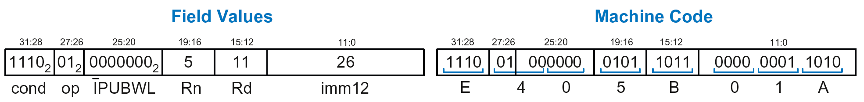
Memory Instr. with Immediate Src2
STR R11, [R5], #-26
Operation: mem[R5] <= R11; R5 = R5 - 26
cond = 1110₂ (14) for unconditional execution
op = 01₂ (1) for memory instruction
funct = 0000000₂ (0)
I = 0 (immediate offset), P = 0 (postindex),
U = 0 (subtract), B = 0 (store word), W = 0 (postindex),
L = 0 (store)
Rd = 11, Rn = 5, imm12 = 26

Slide 180
Memory Instr. with Register Src2
LDR R3, [R4, R5]
Operation: R3 <= mem[R4 + R5]
cond = 1110₂ (14) for unconditional execution
op = 01₂ (1) for memory instruction
funct = 111001₂ (57)
I = 1 (register offset), P = 1 (offset indexing),
U = 1 (add), B = 0 (load word), W = 0 (offset indexing),
L = 1 (load)
Rd = 3, Rn = 4, Rm = 5 (shamt5 = 0, sh = 0)
1110 01 111001 0100 0011 00000 00 0 0101 = 0xE7943005

Slide 181
Memory Instr. with Scaled Reg. Src2
STR R9, [R1, R3, LSL #2]
Operation: mem[R1 + (R3 << 2)] <= R9
cond = 1110₂ (14) for unconditional execution
op = 01₂ (1) for memory instruction
funct = 111000₂ (0)
I = 1 (register offset), P = 1 (offset indexing),
U = 1 (add), B = 0 (store word), W = 0 (offset indexing),
L = 0 (store)
Rd = 9, Rn = 1, Rm = 3, shamt = 2, sh = 00₂ (LSL)
1110 01 111000 0001 1001 00010 00 0 0011 = 0xE7819103

Slide 182
Review: Memory Instruction Format
Encodes: LDR, STR, LDRB, STRB
op = 01₂
Rn = base register
Rd = destination (load), source (store)
Src2 = offset: register (optionally shifted) or immediate
funct = I (immediate bar), P (preindex), U (add),
B (byte), W (writeback), L (load)

Slide 183
Instruction Formats
Data-processing
Memory
Branch

Slide 184
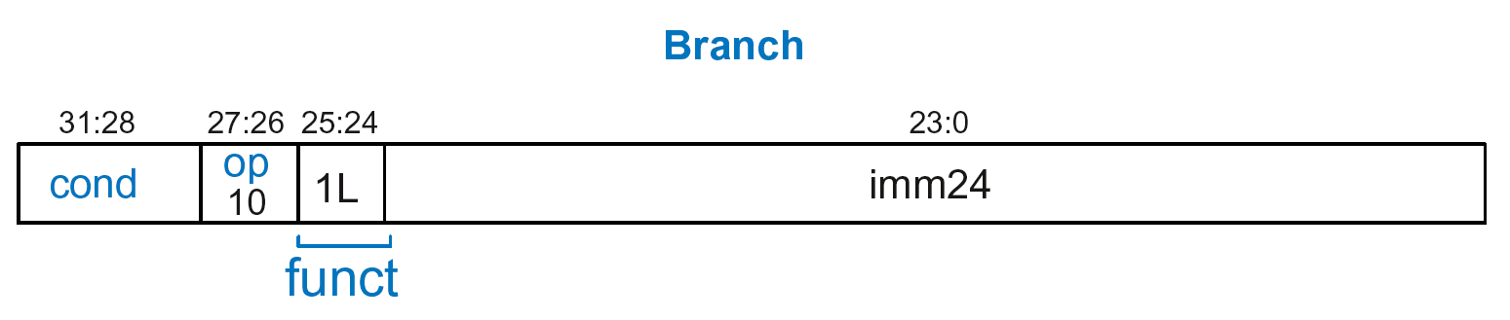
Branch Instruction Format
Encodes B and BL
op = 10₂
imm24: 24-bit immediate
funct = 1L₂: L = 1 for BL, L = 0 for B

Slide 185
Encoding Branch Target Address
Branch Target Address (BTA): Next PC when branch taken
BTA is relative to current PC + 8
imm24 encodes BTA
imm24 = # of words BTA is away from PC+8

Slide 186
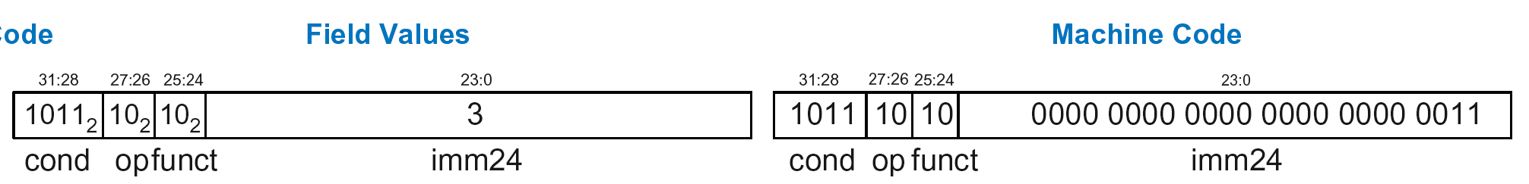
Branch Instruction: Example 1
ARM assembly code
0xA0 BLT THERE
0xA4 ADD R0, R1, R2
0xA8 SUB R0, R0, R9
0xAC ADD SP, SP, #8
0xB0 MOV PC, LR
0xB4 THERE SUB R0, R0, #1
0xB8 BL TEST
PC
PC = 0xA0
PC + 8 = 0xA8
THERE label is 3 instructions past PC+8
So, imm24 = 3
PC+8
BTA
0xBA000003

Slide 187
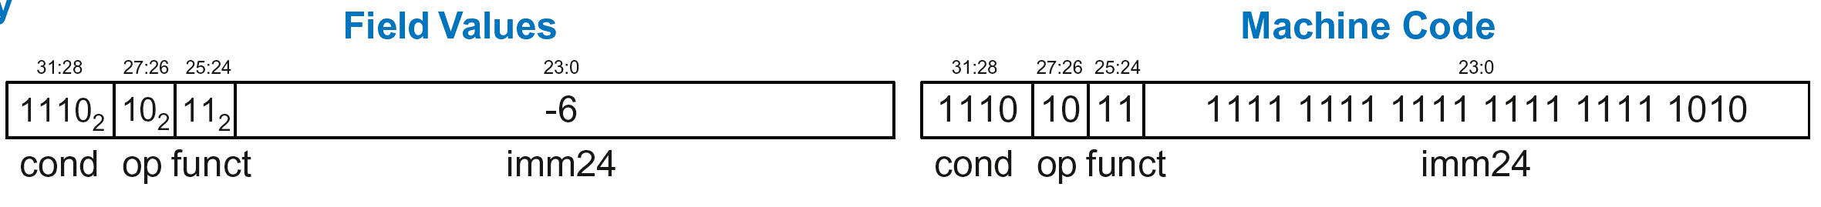
Branch Instruction: Example 2
ARM assembly code
0x8040 TEST LDRB R5, [R0, R3]
0x8044 STRB R5, [R1, R3]
0x8048 ADD R3, R3, #1
0x8044 MOV PC, LR
0x8050 BL TEST
0x8054 LDR R3, [R1], #4
0x8058 SUB R4, R3, #9
BTA
PC = 0x8050
PC + 8 = 0x8058
TEST label is 6 instructions before PC+8
So, imm24 = -6
PC
PC+8
0xEBFFFFFA

Slide 188
Review: Instruction Formats

Slide 189
Conditional Execution
Encode in cond bits of machine instruction
For example,
ANDEQ R1, R2, R3 (cond = 0000)
ORRMI R4, R5, #0xF (cond = 0100)
SUBLT R9, R3, R8 (cond = 1011)

Slide 190
Review: Condition Mnemonics

Slide 191
Conditional Execution: Machine Code

Slide 192
Interpreting Machine Code
Start with op: tells how to parse rest
op = 00 (Data-processing)
op = 01 (Memory)
op = 10 (Branch)
I-bit: tells how to parse Src2
Data-processing instructions:
If I-bit is 0, bit 4 determines if Src2 is a register (bit 4 = 0) or a register-shifted register (bit 4 = 1)
Memory instructions:
Examine funct bits for indexing mode, instruction, and add or subtract offset

Slide 193
Interpreting Machine Code: Example 1
0xE0475001

Slide 194
Interpreting Machine Code: Example 1
0xE0475001
Start with op: 00₂, so data-processing instruction

Slide 195
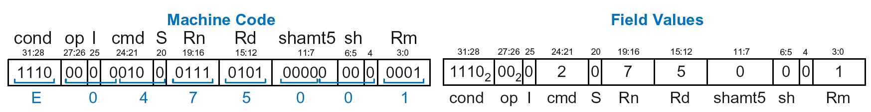
Interpreting Machine Code: Example 1
0xE0475001
Start with op: 00₂, so data-processing instruction
I-bit: 0, so Src2 is a register
bit 4: 0, so Src2 is a register (optionally shifted by shamt5)

Slide 196
Interpreting Machine Code: Example 1
0xE0475001
Start with op: 00₂, so data-processing instruction
I-bit: 0, so Src2 is a register
bit 4: 0, so Src2 is a register (optionally shifted by shamt5)
cmd: 0010₂ (2), so SUB
Rn=7, Rd=5, Rm=1, shamt5 = 0, sh = 0
So, instruction is: SUB R5,R7,R1

Slide 197
Interpreting Machine Code: Example 2
0xE5949010

Slide 198
Interpreting Machine Code: Example 2
0xE5949010
Start with op: 01₂, so memory instruction
funct: B=0, L=1, so LDR; P=1, W=0, so offset indexing;
I=0, so immediate offset, U=1, so add offset
Rn=4, Rd=9, imm12 = 16
So, instruction is: LDR R9,[R4,#16]

Slide 199
Addressing Modes
How do we address operands?
Register
Immediate
Base
PC-Relative

Slide 200
Addressing Modes
How do we address operands?
Register Only
Immediate
Base
PC-Relative

Slide 201
Register Addressing
Source and destination operands found in registers
Used by data-processing instructions
Three submodes:
Register-only
Immediate-shifted register
Register-shifted register

Slide 202
Register Addressing Examples
Register-only
Example: ADD R0, R2, R7
Immediate-shifted register
Example: ORR R5, R1, R3, LSL #1
Register-shifted register
Example: SUB R12, R9, R0, ASR R1

Slide 203
Addressing Modes
How do we address operands?
Register Only
Immediate
Base
PC-Relative

Slide 204
Immediate Addressing
Operands found in registers and immediates
Example: ADD R9, R1, #14
Uses data-processing format with I=1
Immediate is encoded as
8-bit immediate (imm8)
4-bit rotation (rot)
32-bit immediate = imm8 ROR (rot x 2)

Slide 205
Addressing Modes
How do we address operands?
Register Only
Immediate
Base
PC-Relative

Slide 206
Base Addressing
Address of operand is:
base register + offset
Offset can be a:
12-bit Immediate
Register
Immediate-shifted Register

Slide 207
Base Addressing Examples
Immediate offset
Example: LDR R0, [R8, #-11]
(R0 = mem[R8 - 11] )
Register offset
Example: LDR R1, [R7, R9]
(R1 = mem[R7 + R9] )
Immediate-shifted register offset
Example: STR R5, [R3, R2, LSL #4]
(R5 = mem[R3 + (R2 << 4)] )

Slide 208
Addressing Modes
How do we address operands?
Register Only
Immediate
Base
PC-Relative

Slide 209
PC-Relative Addressing
Used for branches
Branch instruction format:
Operands are PC and a signed 24-bit immediate (imm24)
Changes the PC
New PC is relative to the old PC
imm24 indicates the number of words away from PC+8
PC = (PC+8) + (SignExtended(imm24) x 4)

Slide 210
Power of the Stored Program
32-bit instructions & data stored in memory
Sequence of instructions: only difference between two applications
To run a new program:
No rewiring required
Simply store new program in memory
Program Execution:
Processor fetches (reads) instructions from memory in sequence
Processor performs the specified operation

Slide 211
The Stored Program
Program Counter (PC): keeps track of current instruction

Slide 212
Up Next
How to implement the ARM Instruction Set
Architecture in Hardware
Microarchitecture

